Slide 1

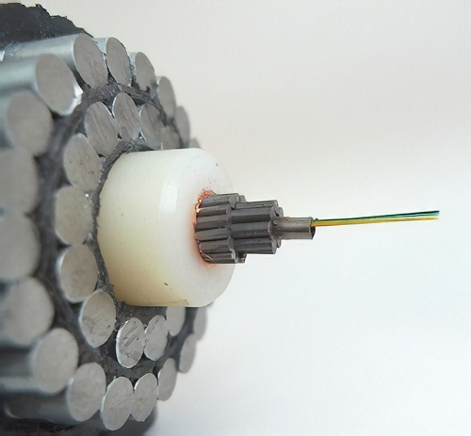

Subsea Optical Network

Slide 2
Subsea Optical Network
Subsea fiber optic networks are responsible for the transmission of 90% of the world’s international data. These underwater fiber optic cables traverse terrain as deep as Mount Everest to deliver valuable information between countries and continents

Slide 3
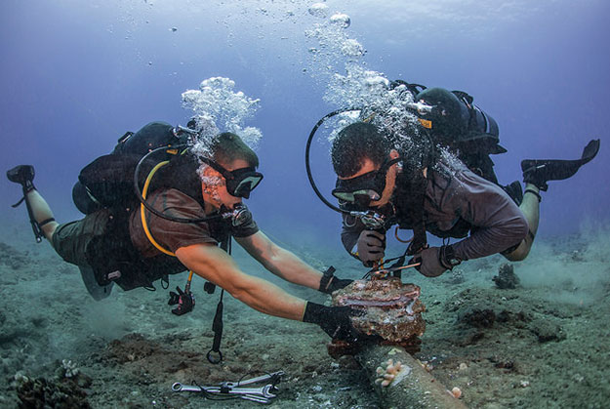
Why do we need more Subsea Fibre Optical cable, Globally
There are 366 subsea cables with 1006 cable landing stations globally and this includes subsea cables that are currently active, under construction, or expected to be fully-funded by the end of 2020. A market survey indicates nearly 30 cables are under construction and new announcements would be in addition to it. Undeniably, that’s quite impressive market landscape of subsea cable

Slide 4
Applying Subsea Technology to new Markets
Undersea fiber optic cables make ideal shared infrastructure to bring higher quality communications to offshore oil and gas platforms and offshore observatories used by scientific research organizations.Undersea cable systems are more flexible, reliable and immune to environmental hazards than satellite or radio connections. Operational effectiveness and safety improves. And large volumes of data can be transported with high quality, high reliability and low latency

Slide 5
Benefits Subsea Optical Network over satellite communication
Underwater submarine cables laid on the sea bed between land-based stations to carry telecommunication signals across stretches of ocean.
It is more durable
Much cheaper
More information is carried
More secured in reliability

Slide 6
How do we communicate with submarines?
Communication with submarines is difficult because radio waves do not travel well through good electrical conductors like salt water. The obvious solution is to surface and raise an antenna above the sea level, then use ordinary radio transmissions. However, a submarine is most vulnerable when on the surface. So by using optical fibre network we can communicate with submarines

Slide 7
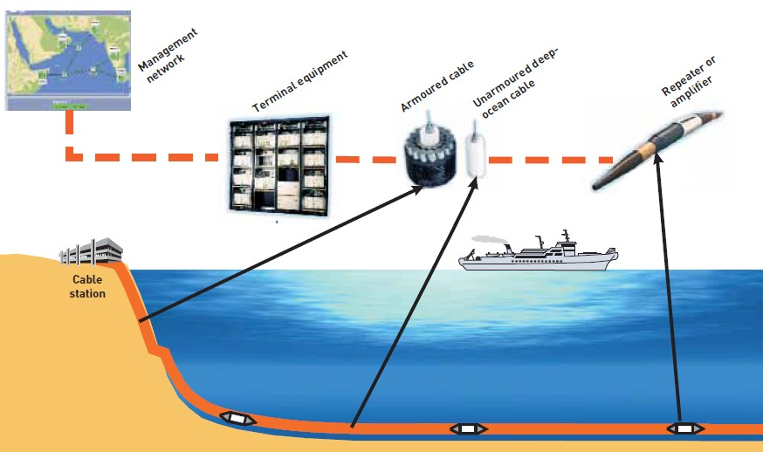
Summary of Submarine Optical Cable System

Slide 8
UPGRADE CAPACITY ON
EXISTING SUBMARINE NETWORKS
Upgrading existing submarine cable systems is a very cost-effective means of adding high-speed capacity
Increase the channel bit rate on an existing lit fiber pair
Increase the channel count on an existing lit fiber pair

Slide 9
Thank You!.....
Presented By
Flightcase IT Services
For more details:
Email - info@fltcase.com
Phone No. - (817) 350-6011

Slide 10




